Slide 1

Predicting Pricing and Cancellation for Hotel Reservations
Course Name: SCS 3253-24 Machine Learning
Instructor: Matt MacDonald
Apr 7th 2020
By:
Farrukh Aziz
Harkaran Singh
Sandeep Borkar
Vijaya Chennupati
Pic link: https://i.ytimg.com/vi/Viyp58DMGng/maxresdefault.jpg

Slide 2


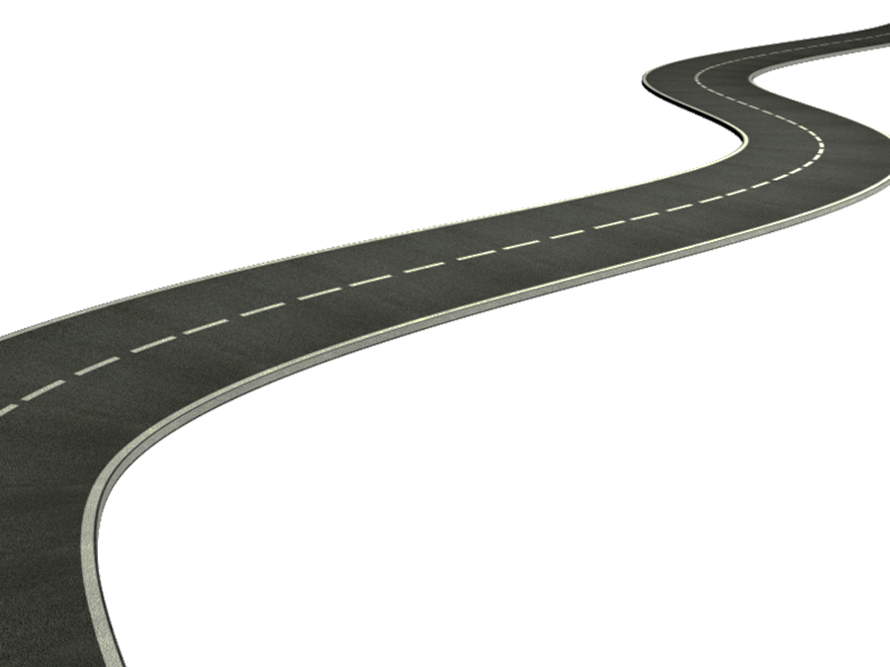
Project Journey
Two Prediction Models for Pricing and Cancellation of Hotel Reservations
Conclusion
Regression Model: Select, Train & Tune
Classification Model: Select, Train & Tune
Feature Scaling and Reduction
Data Exploration & Feature Engineering
Identify Problem and Application
Models and Data Exploration Tools Used
Regression Models:
1. Linear Regression
2. SGD Regression
3. Random Forest Regression
4. Elastic Net
5. Ada Boost Regression
6. Support Vector Regression
Classification Models
7. K-Neighbors Classifier
8. Logistic Regression
9. Random Forest Classifier
10. Support Vector Classifier
11. Decision Tree Classifier
12. Voting Classifier
Other Tools
13. RFECV
14. K-best
15. PCA
16. Grid Search CV
17. Neural Networks

Slide 3


Identify Problem and its Application
Important factors while making a hotel reservation
Price
Location
Reservation Date
Cancellation
Lead Time
Repeat customer
For Customers
For Business
‘Price’ and ‘Cancellation’ are the key factors for any reservation, not just hotel reservation
Problem Identification and its Applicability
Identified the data
Identified the target variables
Application in industry
Data Source – Kaggle
Link to Data Source
https://www.kaggle.com/jessemostipak/hotel-booking-demand
ADR (Average Daily Rate)
Numerical variable
Predict the price of hotel
Is Cancelled?
Categorical variable
Predict whether a reservation will be cancelled
‘Pricing’ and ‘cancellation’ are key parameters for any reservation
Opportunity to replicate in other industries involving reservations
Potential to standardize prediction models for Tourism industry
Two Target Variables to Predict: (1) Average Daily Rate (2) Will it be a Cancellation
Identify Problem and Application
Data Exploration, Feature Engineering
Feature Scaling and Reduction
Conclusion
Regression Model
Classification Model

Slide 4
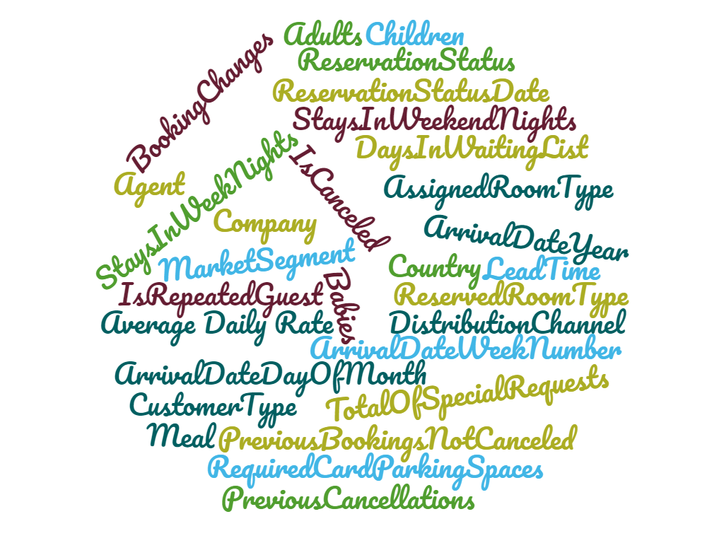
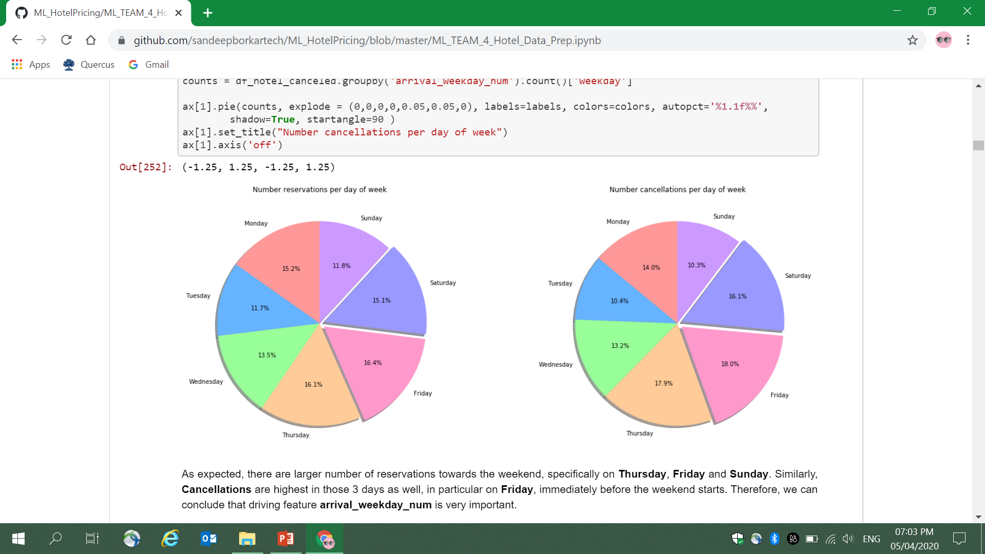
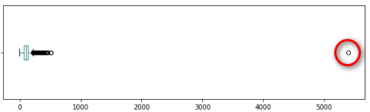
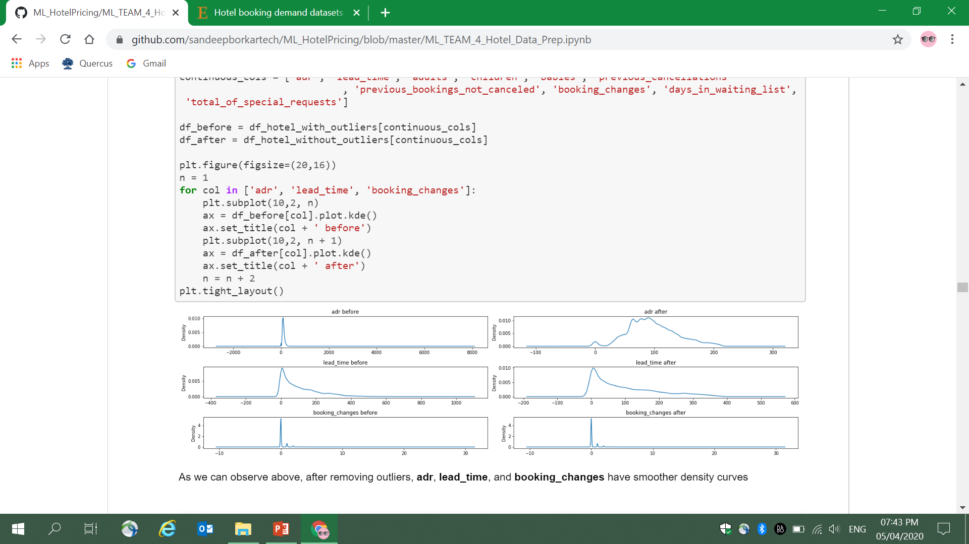
Data Exploration and Feature Engineering
RAW DATA
 |  |  | Industry specific data related to Hospitality ‘Less-explored’ dataset in Tourism industry vis-a-vis PNR data for Aviation
119390
31
2
Number of data points
Number of features
Number of Years
PROCESSED DATA
Data Clean-Up | Feature Engineering | Outlier Removal
1. Blank data (a) Removed blank ‘Country’ data (~0.4%) (b) Replaced blank ‘No. Of children’ data with median value 2. Insufficient data: Removed ‘Country’ data with less than 100 data points 3. Deleted unrelated features | Generated Weekend (YES / NO) and Day of the week from Date Generated ‘Booked through Agent’ (YES/NO) from ‘Agent ID’ Generated ‘Booked through Company’ (Y/N) from Company ID’ One-Hot Encoding for all categorical features | Removed all values greater than (Q3 + 1.5 * IQR) or less than (Q1 – 1.5 * IQR)
Reservations per ‘day of the week’
Cancellations per ‘day of the week’
BOX PLOT: ADR (Average Daily Rate)
BEFORE vs AFTER
Probability density graphs
Q3 = Third quartile or 75th percentile; Q1 = First quartile or 25th percentile; IQR = Inter-Quartile Range (Q3-Q1)
Identify Problem and Application
Data Exploration, Feature Engineering
Feature Scaling and Reduction
Conclusion
Regression Model
Classification Model

Slide 5
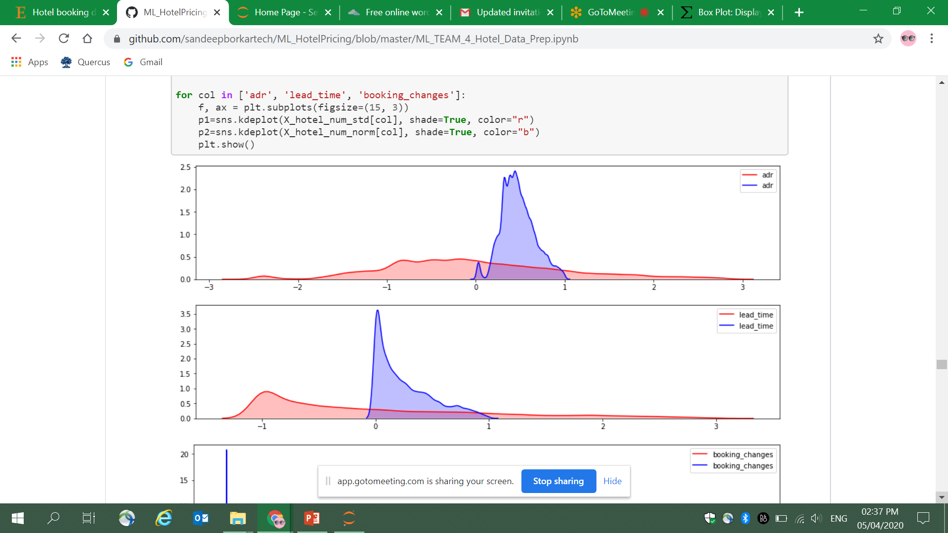
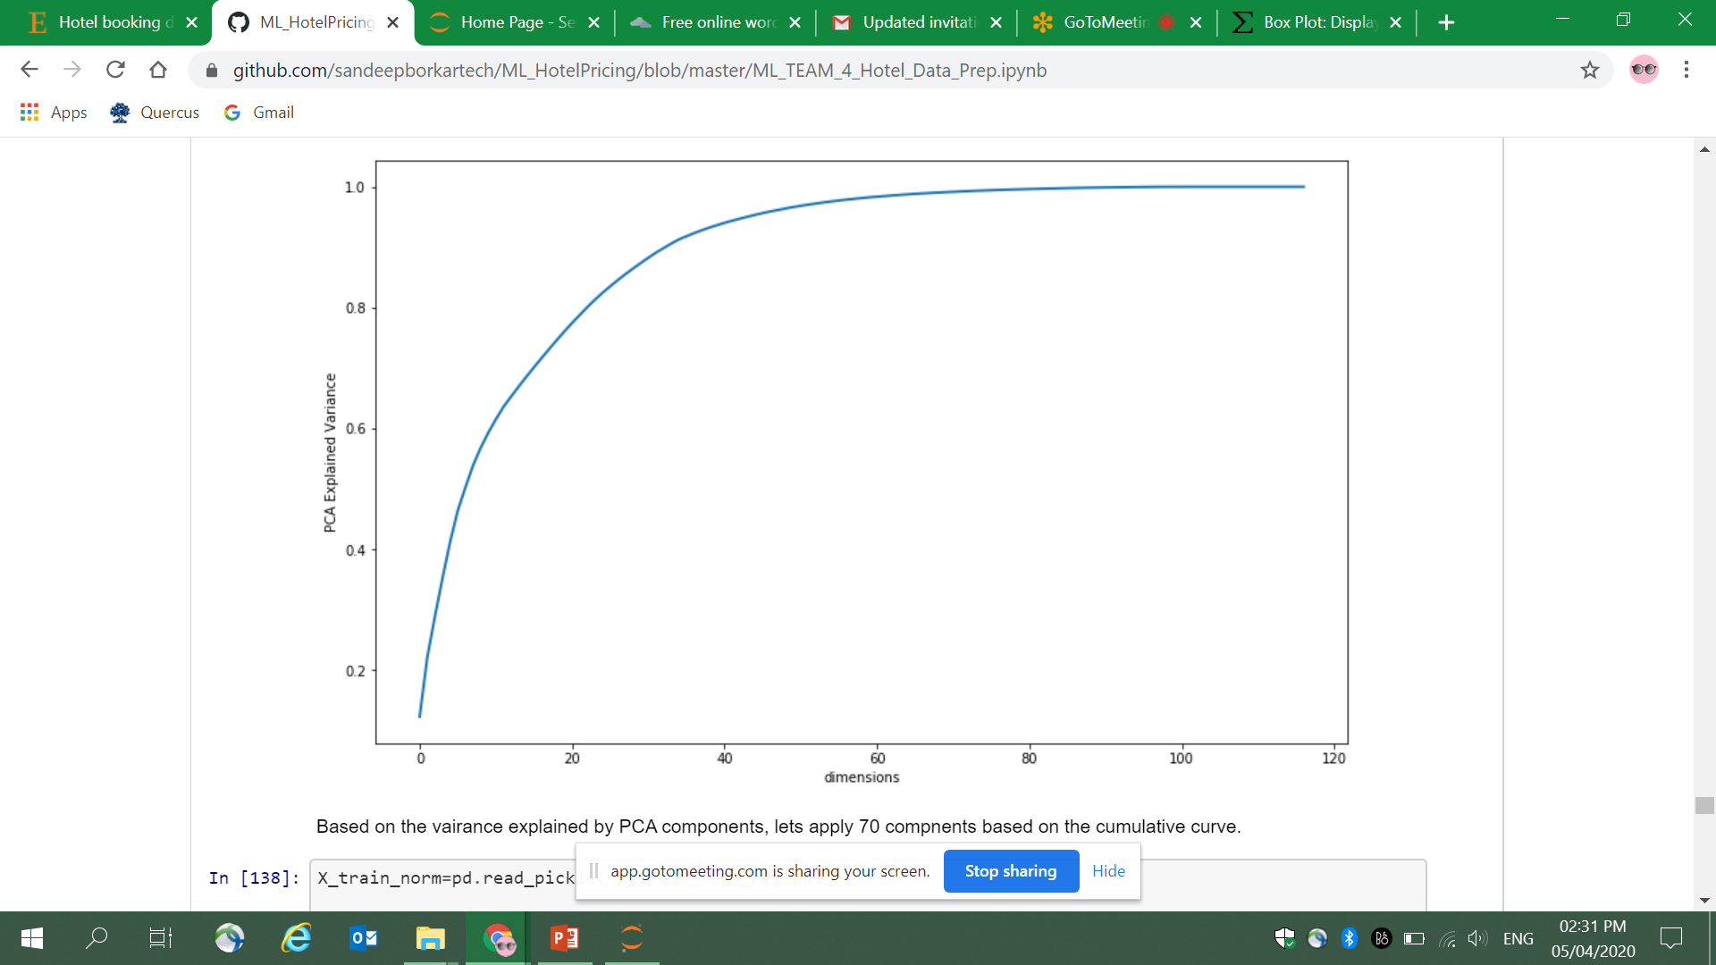
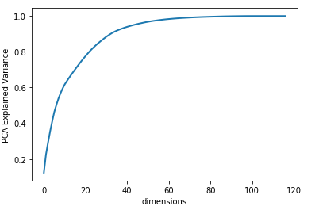
Feature Scaling and Reduction
Feature Scaling
Normalization
Standardization
Normalization vs Standardization
Our dataset has many non-negative features, like price, no. of children etc.
Normalization represents non-negative features better
Standardization has a much wider spread vis-à-vis normalization
Normalization
Standardization
Choose Normalization for feature scaling of our dataset
Feature Reduction / Selection
RFECV
PCA
Regression: Predict Avg. Daily Rate
Classification: Predict Cancellation
Recursive Feature Elimination with Cross-Validation (RFECV) Output (Regression Only)
Optimal number of features : 80
K-BEST
Regression – Predicting Average Daily Rate: Top 60 features
Classification – Predicting cancellation: Top 70 features
*Optimal Number of features: 60
*Optimal Number of features: 70
K-best method gave best results for regression and PCA gave best results for classification
Identify Problem and Application
Data Exploration, Feature Engineering
Feature Scaling and Reduction
Conclusion
Regression Model
Classification Model
Notes:
Some of the top ranking features from K-best include 'lead_time‘
'children‘
'previous_cancellations‘
'previous_bookings_not_canceled‘
'company‘
'days_in_waiting_list', 'mdt_arrival', 'Resort_hotel', 'city_hotel', 'mrkt_seg_Corporate', 'mrkt_seg_Online_TA', 'mrkt_seg_Compmtry', 'mrkt_seg_Undefined', 'rm_tp_F', 'rm_tp_H', 'arr_mth_feb', 'meal_SC', 'depo_tp_Ref', 'distbn_chnl_Dir', 'assn_rm_tp_I'

Slide 6
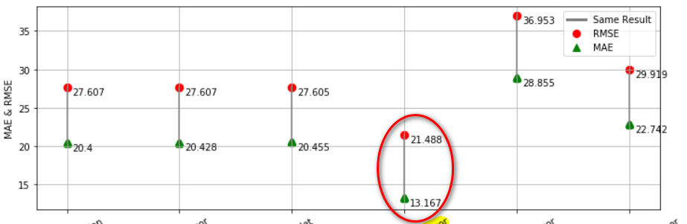
Modelling Regression : Predicting Average Daily Date
Select & Train
Tune and Compare
Identified six models to train :
Linear Regression
Stochastic Gradient Descent (SGD) Regression
Elastic Net
K-Neighbors Regression
Ada Boost Regression
Random Forest Regression
Linear Regression
SGD Regression
Elastic Net
K-Neighbors Regressor
AdaBoost Regressor
Random Forest Regressor
Results
K-Neighbors Regression gives best results
MAE (Mean absolute error): 13.167
RMSE (Root mean square error): 21.488
Tuned Hyperparameters for K-Neighbors Regression
leaf_size = 30
n_neighbors = 3
p = 2
Identify Problem and Application
Data Exploration, Feature Engineering
Feature Scaling and Reduction
Conclusion
Regression Model
Classification Model

Slide 7
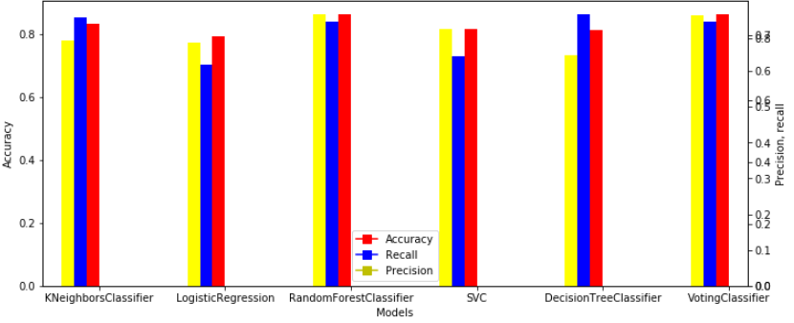
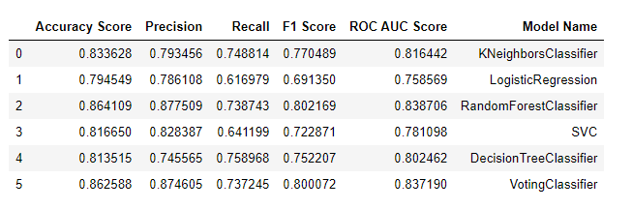
Modelling Classification: Predicting Cancellation
Select & Train
Tune and Compare
Conclusion
Identified six models to train :
K-Neighbors Classifier
Logistic Regression
Random Forest Classifier
Support Vector Classifier (SVC)
Decision Tree Classifier
Voting Classifier
Random Forest Classifier (RFC) and Voting classifier (VC) give the best results on each of the following parameters
Accuracy
Precision
F1 score
ROC AUC score
Decision Tree Classifier provides best results for Recall; about 2-3% better than RFC and VC
Identify Problem and Application
Data Exploration, Feature Engineering
Feature Scaling and Reduction
Conclusion
Regression Model
Classification Model

Slide 8
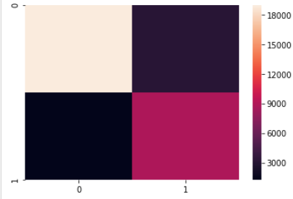
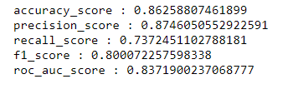
Results Classification: Predicting Cancellation
Choose Model
Tuned Hyperparameters
K-Neighbors Classifier: n_neighbors = 10, weights = ‘distance’
Logistic Regression: solver = ‘lib linear’, tol = 0.0001, c = 1.0
Random Forest Classifier: n_estimators = 10, criterion = gini
Support Vector Classifier: c = 1.0, kernel = rvf, tolerance = 0.001
Decision Tree Classifier: splitter = ‘best’
Voting Classifier: voting = ‘hard’
Choose Voting classifier (VC)
Alongwith Random Forest Classifier (RFC), VC gives the best results for Accuracy and Precision
The recall score is only ~3% less than the best result
Choose VC over RFC, since it compares other models (including RFC) and generally provides best results
Voting classifier (VC) Results
Confusion Matrix
Identify Problem and Application
Data Exploration, Feature Engineering
Feature Scaling and Reduction
Conclusion
Regression Model
Classification Model

Slide 9
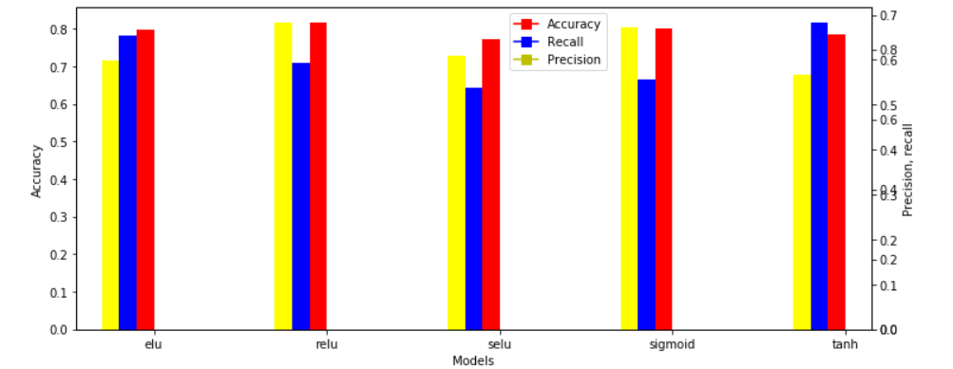
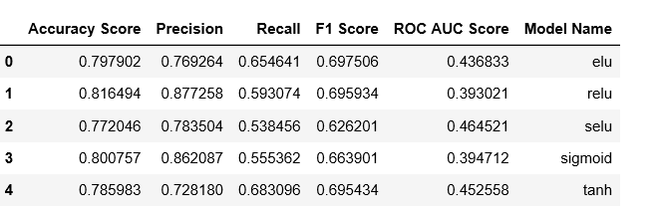
Neural Network (TensorFlow)
Summary
Neural Networks applied to predict cancellations using three layers with following perceptron information:
Layer 1: 256 units
Layer 2: 128 units
Layer 3: 1 unit
Plotted model graph with different activation functions : elu, relu, selu, sigmoid, tanh
All activation scores performed well as recall is over 0.5
Overall, ‘relu’ activation function provided best results followed by ‘sigmoid’
Identify Problem and Application
Data Exploration, Feature Engineering
Feature Scaling and Reduction
Conclusion
Regression Model
Classification Model
Notes:
"""Train an Multilayer Perceptron (MLP) with TensorFlow - Keras API"""
Loss function, Accuracy
relu- [0.3609906734423616, 0.8394947] selu - [0.38405117149714463, 0.81708413] elu - [0.380795744237877, 0.8159357] tanh - [0.39610912362878786, 0.81432164] relu (optimized)- [0.3583572881965955, 0.82940686]

Slide 10
Conclusion
Applications of the Model
Model Limitations
As a customer, predict the price of hotel and plan vacation
As a hotel owner, predict whether a reservation will be cancelled to enable
Better Logistics planning
Estimation of overbooking required
Potential to replicate in other reservation related transactions
Built on data from two hotels only, which can increase the chances of overfitting
Method of removing outliers chosen was 1.5 IQR from Q1 and Q3, which could lead to loss of data
Potential loss of data due to removing ‘Country’ data : blank and less than 100 data points
Challenges and Learnings
Future Enhancements
Machine limitation leading to
Restriction in using range of hypermeters
Unable to use models like Gradient boost and Adaboost
Virtual working during COVID-19
Identified virtual work tools
Apply similar steps for any reservation related model, including flight reservation, appointment reservation etc.
Can be generalized to any regression and classification problem as our model covers both methods in depth
Scope for further research to identify underlying clusters in the data
Identify Problem and Application
Data Exploration, Feature Engineering
Feature Scaling and Reduction
Conclusion
Regression Model
Classification Model

Slide 11
Thank You!

